Slide 1

GRAVIXIA TECHNOLOGY
https://www.gravixia.com

Slide 2
Gravixia's Key Solutions
Automated Document Signing
1
Credit Card Security
2
Data Security via Cryptography
3
Gravixia delivers advanced cryptography for data security, document signing, and credit card protection. Our innovative solutions safeguard your digital assets with cutting-edge technology.

Slide 3
Offers complete E-sign solution to provide Digital signature from USB Token , Smartcards & Aadhar based E-Sign. Save your confidential document into your Organization Network. Document never leaves your Organization Network and It offers comprehensive security.
- ESIGN Solution

Slide 4

Key Features of Gravixia's E-Sign Solution
1
Web-Based Digital Signature
2
Smartcard and USB Token Support
Addresses international security concerns.
Enables digital signatures with shared access.
3
Document Collaboration
4
Bulk E-Sign
Facilitates secure document sharing.
Automate Signing process . One click Bulk signature

Slide 5

Gravixia's Unique Approach
No Document Storage
Secure Email
Unlike competitors, Documents are stored in user's organization network.
Unlike competitors, Emails are sent through the user's organization email account.
Bulk E-Sign
Create documents in MS Word format. We convert document to PDF
and place signature automatically to all docs. No Code signing experience.
Digital Signature
Customize Signatures
Unlike competitors, Gravixia supports USB / Smart card and Aadhar based digital signature.
Unlike competitors, Gravixia signatures can be customized.

Slide 6
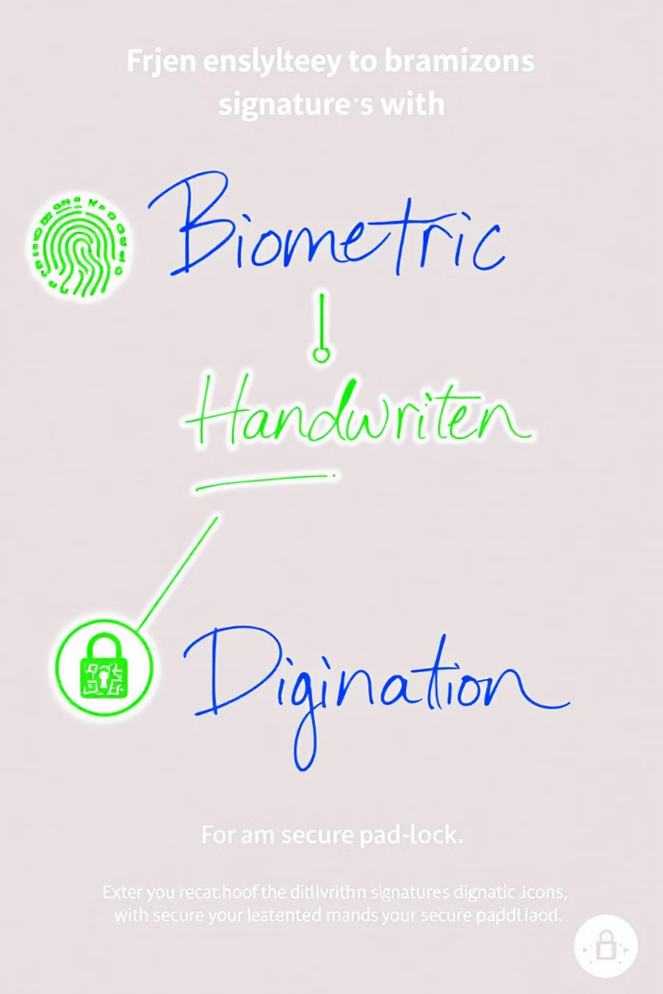



Comprehensive E-Sign Solution
USB Token
Smartcards
Aadhar E-Sign
Digital signatures from USB tokens.
Digital signatures from smartcards.
Supports Aadhar-based E-Sign.

Slide 7

Handwritten Signatures
1
Faster & More Secure
Saves confidential documents in your ORG network.
2
Signature Location
Drag and Drop signature in Document.
3
Customize Signature
Customize signature font , style and text using MS WORD
4
Reviewer Signature
Saves Reviewer Signature file ( jpeg ) in Reviewer’s ORG Network.

Slide 8





Digital Signature
USB & Smart Card
Aadhar ESIGN
Drag & Drop
Reviewers Safety
Generates digital signatures through smart card and usb.
Generates digital signatures through Aadhar Esign.
.
Drag & Drop signature on any document location.
Reviewers Digital Certificate saved in their ORG network.

Slide 9





Bulk Signature
Customized Signature
Generate fancy document in word and place signature
Bulk Signing
No code experience . Converts office documents to PDF and sign.
Bulk Signing API
Bulk signing API available for advance users.
Storage in ORG Network
Confidential document storage capability in Your ORG network.

Slide 10

Document Collaboration
Track Chage Mode
Collaboration
Review document in Track change mode.
Multiple stakeholder can change document in Track change Mode.
ORG Network
Save confidential documents in your Network.
Document workflow
Email
Document workflow to check document review status.
Email Notification and Reminders to Reviewer.

Slide 11

Key Advantages
1
Secure
SOW & NDA stored in your ORG Repository.
2
Desktop & Mobile
USB Token signature supported in Desktop App
3
Bulk Signing
No code experience to generate desired bulk signature.

Slide 12

Value Proposition ESIGN
1
Superior Technology
2
Comprehensive Suite
Supports SIX different platform. Web App , Desktop App, Mobile App on Windows ,MacOS and Linux.
Digital signature through Smart card . USB Tokens and Aadhar E-Sign along with Handwritten signatures.
3
Extreme Security
On Prem Desktop App , document never leaves your ORG network.

Slide 13
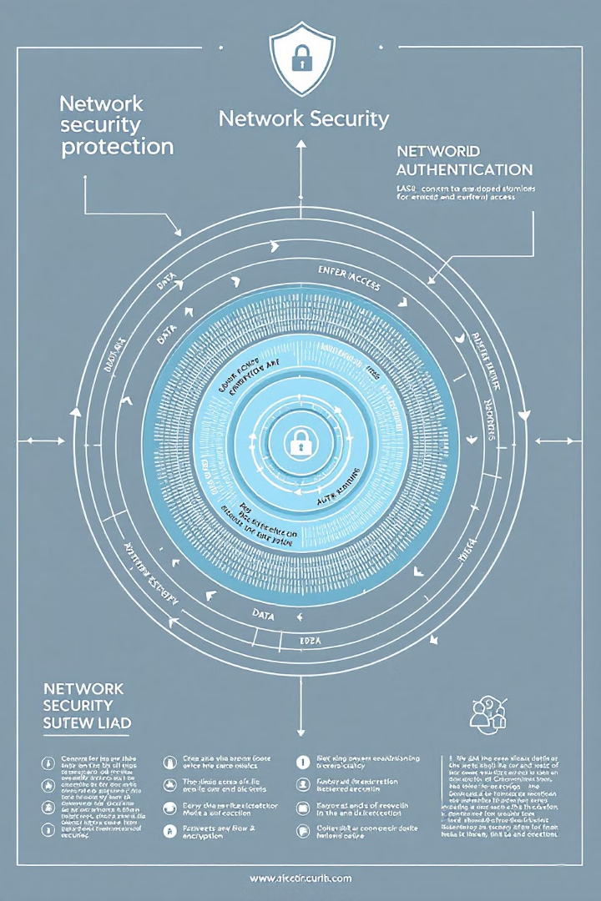
Network Cryptography –Innovation ( most valuable slide )
1
Unique Solution enables web based signature
Better solution than Aadhar E-SIGN
2
Gravixia never stores end user private key
Technically without user consent digital signature can not be generated.
3
Two-Factor Authentication
Implements two-factor authentication.
4
User Consent
One cannot generate digital signature without user consent. OTP is sent.
* Please ask questions if information is cryptic

Slide 14
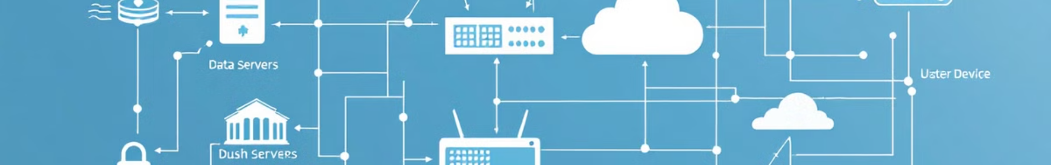
Value Proposition of Network Cryptography
Hardware Protection
1
Secures stolen hardware devices.
2
Two-Factor Authentication
Enables two-factor authentication.
Superior Technology
3
Better web based solution than Aadhar E-Sign.
4
Web Based Solution
Digitally sign the document without security fear.

Slide 15
Contact US :
Deepak Kumar Singh
deepak@gravixia.com
+91-9873476609
Mrs. Shambhavi
shambhavi@gravixia.com

